Slide 1
מרץ 2018 22
זה ממש לא עברית
這不是真正的希伯來文
这不是真正的希伯来文
それは本当にヘブライではない
정말로 히브리어가 아닙니다.

Slide 2
L LC PILOT PROJECT PHASE 1
Forty-four Library of Congress
catalogers participated in
the BIBFRAME Pilot, Phase 1

Slide 3
L LC PILOT PROJECT PHASE 1
Phase 1 started in September 2015,
lasted 6 months for some catalogers, continues for others a few months
longer :
May 31st, 2016
July 31st, 2016

Slide 4
L LC PILOT PROJECT PHASE 1
BIBFRAME Pilot Project, Phase 2
June 2017 to present

Slide 5
L LC PILOT PROJECT PHASE 1
As a result from the Pilot Project Phase 1, the Library of Congress has …
… natively created BIBFRAME data
… training experience of participants
…information on what it takes technically
… experience in using the BIBFRAME Editor and how it can be improved
… experience in using LC.id.gov/Authorities as the source of authoritative headings to assess

Slide 6
L LC PILOT PROJECT PHASE 1
My experience in using the BIBFRAME Editor (1)
Training
Module 1: Introduction to the semantic web and linked data
Module 2: Introduction to the BIBFRAME tools
Module 3: The BIBFRAME Editor and the LC Pilot

Slide 7
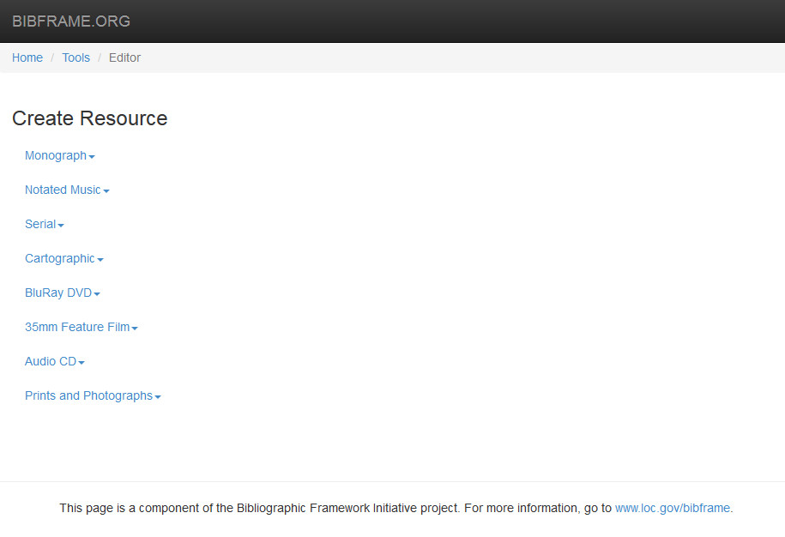
L LC PILOT PROJECT PHASE 1
My experience in using the BIBFRAME Editor (2)

Slide 8
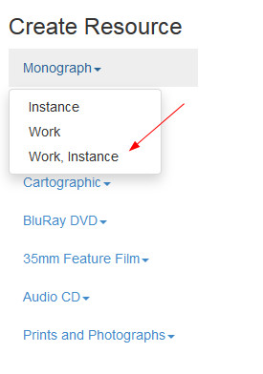
L LC PILOT PROJECT PHASE 1
My experience in using the BIBFRAME Editor (3)

Slide 9
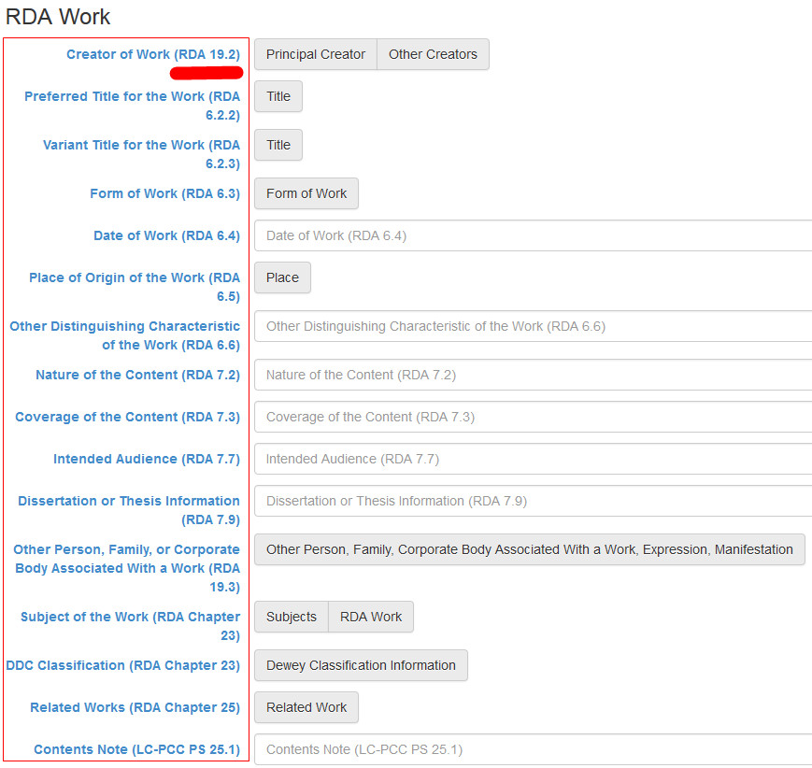
L LC PILOT PROJECT PHASE 1
My experience in using the BIBFRAME Editor (4)

Slide 10
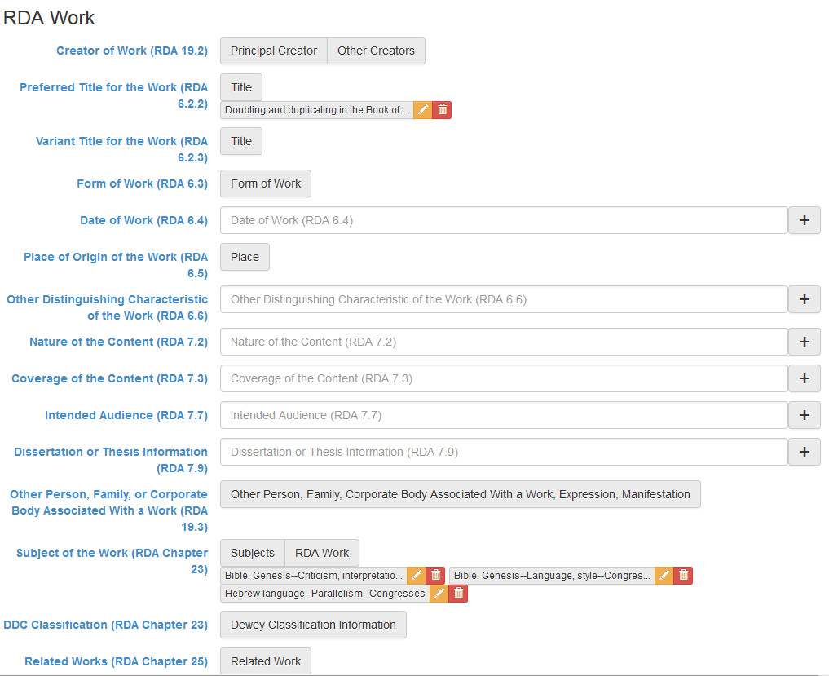
L LC PILOT PROJECT PHASE 1
My experience in using the BIBFRAME Editor (5)

Slide 11
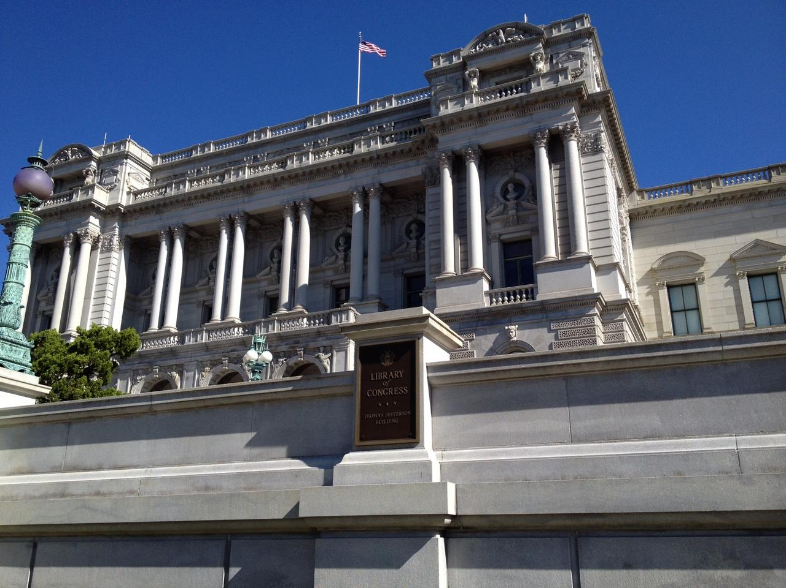
BibFrame 2.0

Slide 12
BIBFRAME Pilot 2.0
begins officially on June 1, 2017
training and implementation done in two phases
------------------------------------------------------------------------
The new profiles of the BIBFRAME 2.0 Editor: Agents and Authorities
Other new features of BIBFRAME 2.0 profiles
BibFrame 2.0

Slide 13
Format specific sessions for current pilot participants:
• Monograph/Serial combined sessions
• Music/Cartographic combined sessions
• Prints and Photographs/AV/Sound Recording
Training sessions was in classrooms for Capitol Hill staff members and via webinar for Culpepper staff members
BibFrame 2.0
Notes:
Now to the topic I was asked to cover. My experience with BibFrame Editor [PAUSE]
Forty-four Library of Congress catalogers participated in the BIBFRAME Pilot, Phase One, describing resources in BIBFRAME for monographs, [PAUSE] notated music, [PAUSE] serials, [PAUSE] maps, [PAUSE] atlases, [PAUSE] sound recordings, [PAUSE] and audio visual materials [PAUSE] using Resource Description & Access (RDA)
‹#›

Slide 14
BIBFRAME 2.0 Features
In addition to the use of BIBFRAME 2.0 vocabulary, the 2.0 version will have revised profiles ; catalogers will be able to save and retrieve data, and authority control will be more robust
BIBFRAME 2.0 Decisions
Database will not be the database of record
Records will not be converted to MARC
Training materials will be mounted on the web
BibFrame 2.0

Slide 15
HOW IS
PHASE 2
DIFFERENT
FROM
PHASE 1 ?
BibFrame 2.0

Slide 16
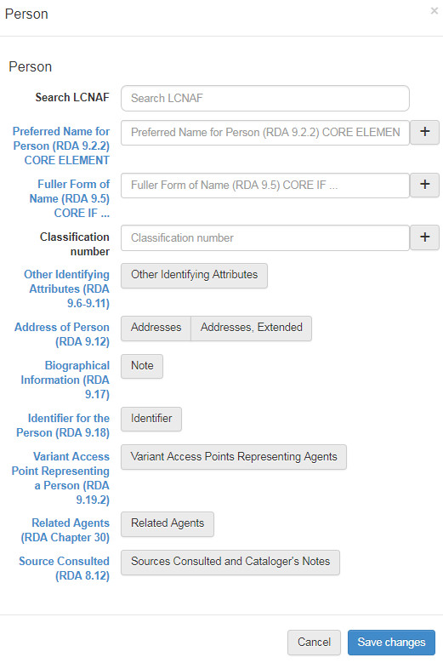
WORKFLOW MANAGEMENT
BibFrame 2.0

Slide 17
AREAS
OF
FUTURE DEVELOPMENT
IN
BIBFRAME EDITOR
BibFrame 2.0

Slide 18
Searching with diacritics – 1 -
טייטלבוים, ארי' לייב Ṭaiṭelboim, Ary. Leyb
First search =Ṭaiṭelboim, Ary. Leyb (with diacritics)
First result LCNAF No suggestion found for Ṭaiṭelboim, Ary. Leyb
Second search = Taitelboim, Ary. Leyb (without diacritics)
Second result LCNAF Ṭaiṭelboim, Ary. Leyb
BibFrame 2.0

Slide 19
Searching with diacritics – 2 -
מנצור, עזריאל Mantsur, ʻAzriʼel
First search = Mantsur, ʻAzriʼel (with diacritics)
First result LCNAF Mantsur, ʻAzriʼel
BibFrame 2.0

Slide 20
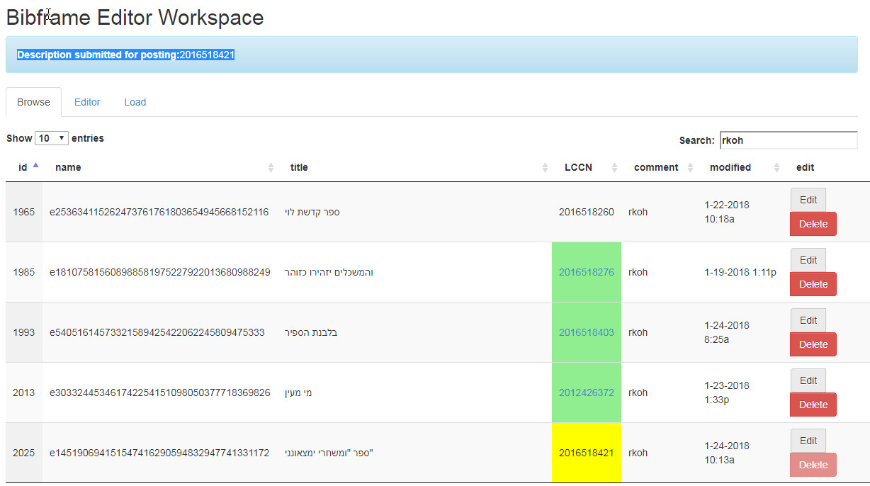
What happens to a completed record? - 1 -
BibFrame 2.0

Slide 21
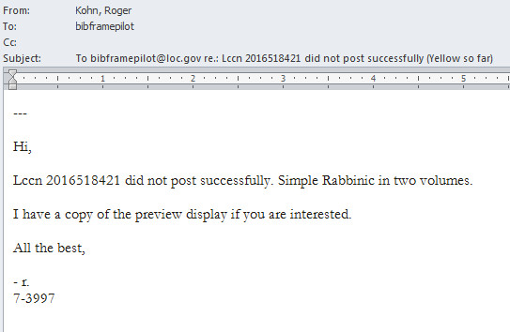
What happens to a completed record? - 2 -
BibFrame 2.0

Slide 22
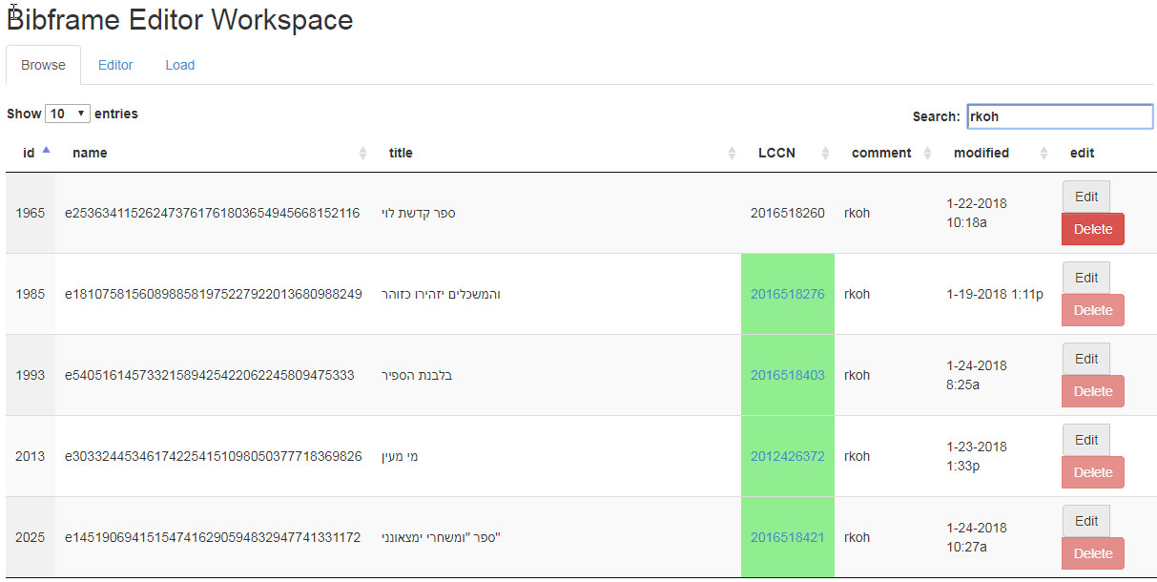
What happens to a completed record? - 3 -
BibFrame 2.0

Slide 23
מרץ 2018 22
זה סינית בשבילי
(“This is Chinese to me”)
This is Greek to me
C’est de l’ hébreu pour moi
這是我的中文
这是我的中文
これは私にとって中国語です
이것은 나를 위해 중국어입니다.
Thank you !
Roger Kohn (rkoh@loc.gov)

Slide 24
Presentation Outline
---
-
BibFrame 2.0

